Slide 1
Image Super-Resolution Using Machine Learning
(GROUP – 04)
Name | ID
Md. Sifur Rahman | 1620018042
MD. Rokib Hasan Oli | 2211950642
Kazi Eraj Al Minahi Turjo | 1831906642

Slide 2
Problem Statement
Low-resolution images suffer from:
Blur
Loss of details
Poor texture quality
Weak edge sharpness
Traditional methods like:
Nearest Neighbor
Bilinear
Bicubic Interpolation
cannot recover lost details effectively.

Slide 3

Project Objective
Main Goal:
Build a machine learning model that can: LR Image → HR Image
Specifically:
Collect 100 random images
Create HR-LR paired dataset
Train ESPCN model for 4x upscaling
Compare with Bicubic Interpolation
Evaluate using PSNR

Slide 4
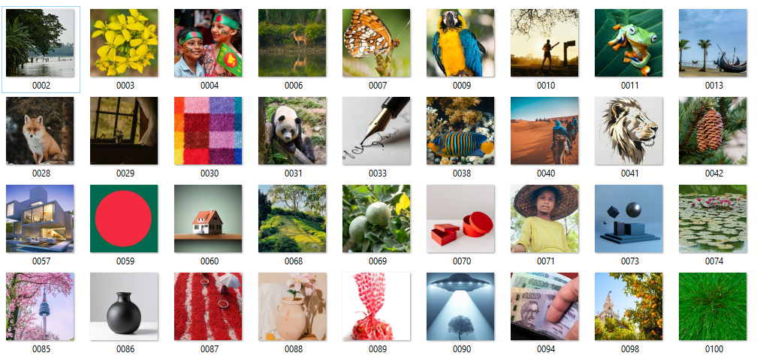
Dataset Preparation
Original Images:
100 random internet images
Standardization:
HR Images: 256 × 256
LR Images: 64 × 64 (4x downscaled)
Final Dataset:
149,490 augmented HR-LR paired samples
Data Split: 80% Train, 10% Validation, 10% Test.

Slide 5
Data Augmentation
Used:
Horizontal Flip
Vertical Flip
Rotation
Patch Extraction
Benefits:
More training samples
Better generalization
Reduced overfitting

Slide 6
Model Architecture
ESPCN Model (Efficient Sub-Pixel Convolutional Neural Network)
Main Components:
Convolution Layers
Feature Extraction
PixelShuffle Layer
Upscaling Factor: 4×

Slide 7
Why ESPCN?
Compared to Bicubic:
Bicubic:
Fixed mathematical rule
Smooth but blurry
ESPCN:
Learns from data
Recovers sharper textures
Better detail reconstruction

Slide 8

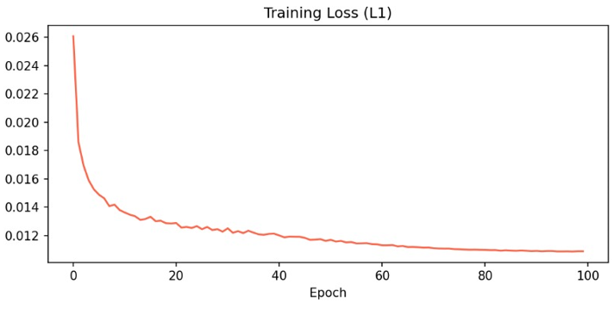
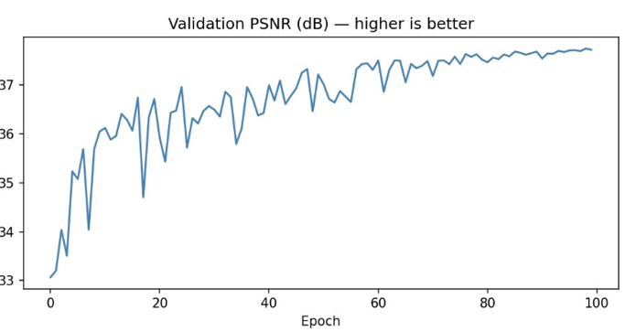
Training Setup
Parameter | Value
Epochs | 100
Batch Size | 16
Loss Function | L1 Loss
Optimizer | Adam
Scheduler | CosineAnnealingLR
Evaluation | PSNR
GPU | RTX 5060 Ti
Mixed Precision | GradScaler

Slide 9
Evaluation Method
Numerical Evaluation:
PSNR (Peak Signal-to-Noise Ratio)
Visual Comparison:
LR Input
Bicubic Output
ESPCN Output
Original HR Image

Slide 10
Results
Image Type | Bicubic | ESPCN | Gain
Grass | 26.96 dB | 32.67 dB | +5.71
Tower | 24.20 dB | 29.95 dB | +5.74
Leaf | 21.74 dB | 26.66 dB | +4.92
Cloth | 37.15 dB | 41.46 dB | +4.31
Blurred scene | 22.55 dB | 26.36 dB | +3.81

Slide 11
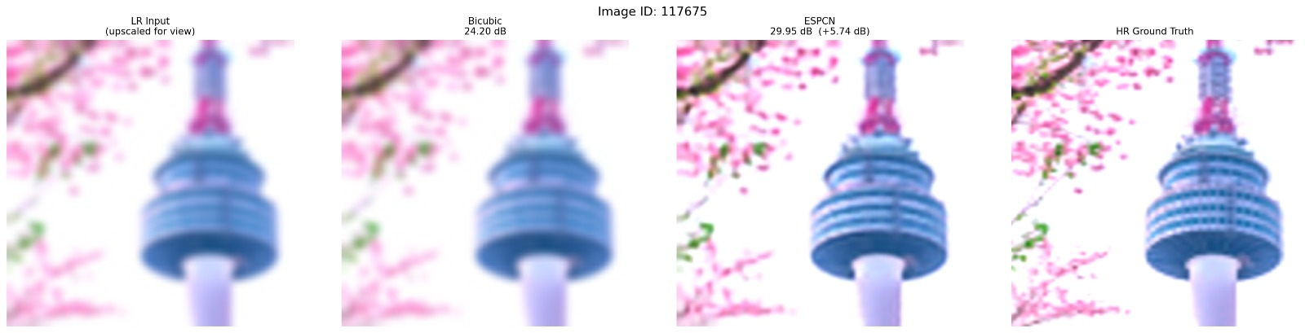
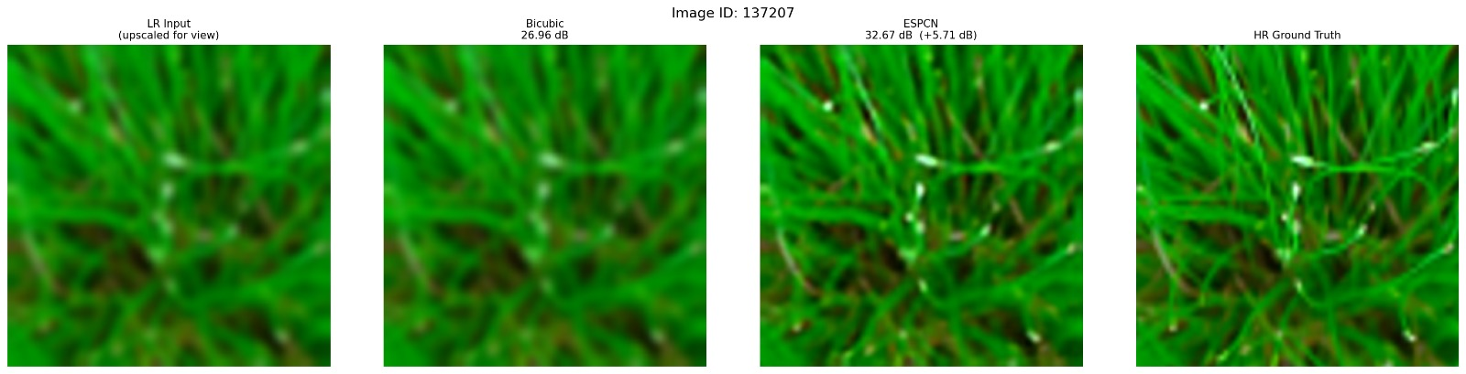
Visual Output

Slide 12
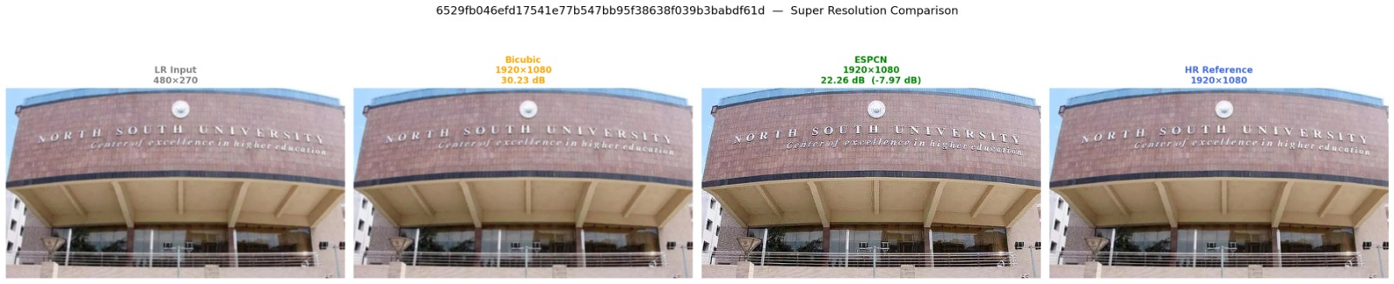
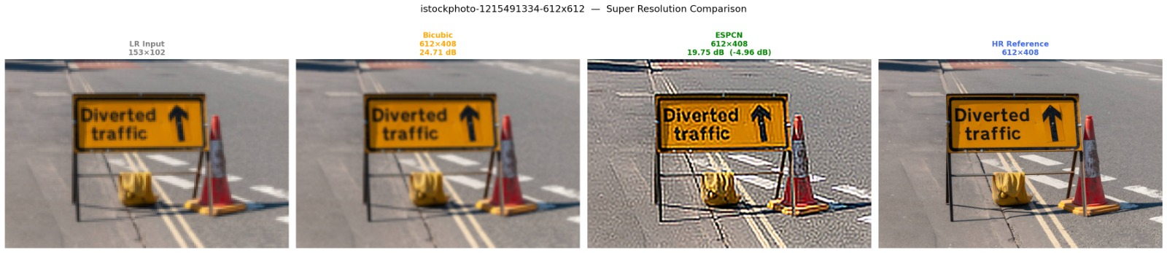
Visual Output

Slide 13
Limitations & Future Work
Limitations
Small original dataset
PSNR not always reflects visual quality
Some artifacts may appear
Future Work
Larger dataset
Add SSIM metric
Compare with SRCNN / EDSR / ESRGAN
Build user interface

Slide 14
Conclusion
ESPCN successfully improved:
Sharpness
Texture quality
Edge reconstruction
and outperformed Bicubic Interpolation in many test cases.

Slide 15
Thank you.

